Slide 1

Presentation on Java Programming (IT207G)
UNIT No. VI- 2
Notes:
This template can be used as a starter file to give updates for project milestones.
Sections
Right-click on a slide to add sections. Sections can help to organize your slides or facilitate collaboration between multiple authors.
Notes
Use the Notes section for delivery notes or to provide additional details for the audience. View these notes in Presentation View during your presentation.
Keep in mind the font size (important for accessibility, visibility, videotaping, and online production)
Coordinated colors
Pay particular attention to the graphs, charts, and text boxes.
Consider that attendees will print in black and white or grayscale. Run a test print to make sure your colors work when printed in pure black and white and grayscale.
Graphics, tables, and graphs
Keep it simple: If possible, use consistent, non-distracting styles and colors.
Label all graphs and tables.

Slide 2
Parameter in Applet
parameter passing refers to the process of passing data or parameters from the HTML code that embeds the applet into a web page ..
This mechanism allows you to customize and configure the behavior of the applet dynamically based on the values provided in the HTML code..
Step 1: Embedding the Applet in HTML: To embed a Java applet in an HTML page, you typically use the <applet> tag. Within this tag, you can specify various parameters using the <param> tags.
<param name="param1" value="value1">
Step 2: Accessing Parameters in the Applet: Inside the Java applet code, you can access the parameters passed from the HTML page using the getParameter() method of the Applet class..
String str=getParameter("param name");
Notes:
Duplicate this slide as necessary if there is more than one issue.
This and related slides can be moved to the appendix or hidden if necessary.

Slide 3
UseParam.java
import java.applet.Applet;
import java.awt.*;
public class UseParam extends Applet{
public void init()
{
setBackground(Color.red);
setForeground(Color.green);
}
public void paint(Graphics g)
{
String str=getParameter("msg");
g.drawString(str,50, 50);
}
}
/*<applet code="UseParam.class" width="300" height="300">
<param name="msg" value="Welcome to applet">
</applet> */
Notes:
Duplicate this slide as necessary if there is more than one issue.
This and related slides can be moved to the appendix or hidden if necessary.

Slide 4
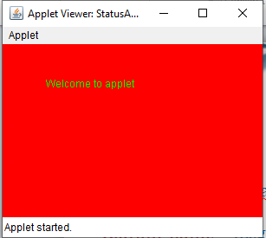
Command Prompt:
c:\>javac UseParam.java
c:\>appletviewer myapplet.java
Notes:
Duplicate this slide as necessary if there is more than one issue.
This and related slides can be moved to the appendix or hidden if necessary.

Slide 5
Practical:
Write a program to pass two parameters in Applet, One contains your full name and another will be your branch name. Display both the parameters on applet screen.

Slide 6
Displaying Graphics in Applet
java.awt.Graphics class provides many methods for graphics programming..
public abstract void drawString(String str, int x, int y): is used to draw the specified string.
public void drawRect(int x, int y, int width, int height): draws a rectangle with the specified width and height.
public abstract void fillRect(int x, int y, int width, int height): is used to fill rectangle with the default color and specified width and height.
public abstract void drawOval(int x, int y, int width, int height): is used to draw oval with the specified width and height.
Notes:
Duplicate this slide as necessary if there is more than one issue.
This and related slides can be moved to the appendix or hidden if necessary.

Slide 7
5. public abstract void fillOval(int x, int y, int width, int height): is used to fill oval with the default color and specified width and height.
6. public abstract void drawLine(int x1, int y1, int x2, int y2): is used to draw line between the points(x1, y1) and (x2, y2).
7. public abstract void drawArc(int x, int y, int width, int height, int startAngle, int arcAngle): is used draw a circular or elliptical arc
8. public abstract void fillArc(int x, int y, int width, int height, int startAngle, int arcAngle): is used to fill a circular or elliptical arc.
9. public abstract void setColor(Color c): is used to set the graphics current color to the specified color.
10. public abstract void setFont(Font font): is used to set the graphics current font to the specified font.

Slide 8
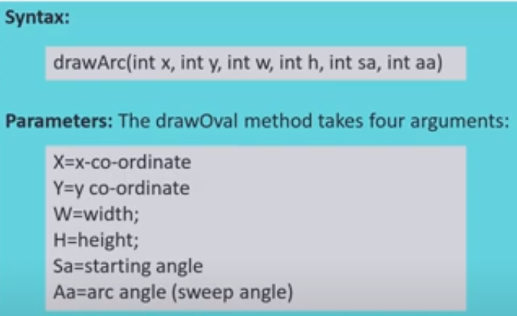
How to drawArc() and fillArc() work?
Notes:
Duplicate this slide as necessary if there is more than one issue.
This and related slides can be moved to the appendix or hidden if necessary.

Slide 9

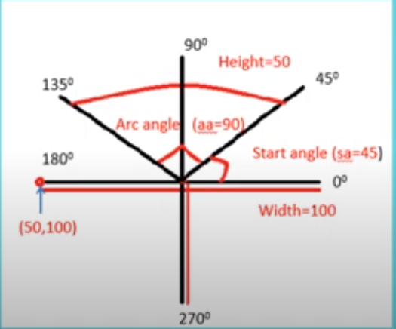
How to drawArc() and fillArc() work?
Notes:
Duplicate this slide as necessary if there is more than one issue.
This and related slides can be moved to the appendix or hidden if necessary.

Slide 10
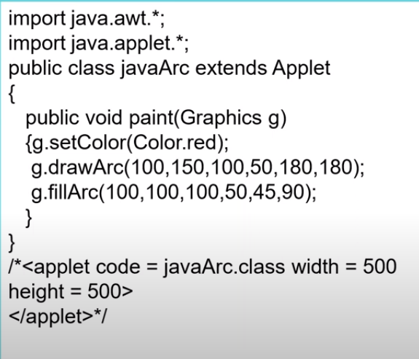
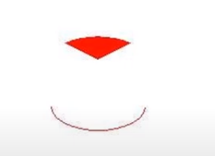
Example Program for drawArc() and fillArc() method
Notes:
Duplicate this slide as necessary if there is more than one issue.
This and related slides can be moved to the appendix or hidden if necessary.

Slide 11

Practical:
Write program to create applet having following graphics in it.

Slide 12
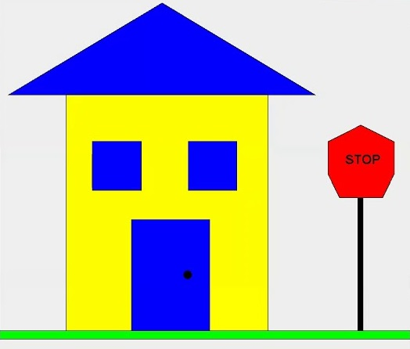
Practical:
Write program to create applet having following graphics in it.

Slide 13
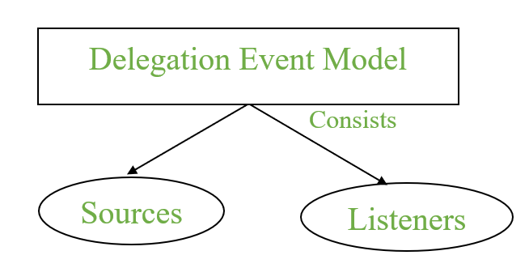
AWT Event Handling
It is a mechanism to control the events and to decide what should happen after an event occur. To handle the events, Java follows the Delegation Event model.
Notes:
Duplicate this slide as necessary if there is more than one issue.
This and related slides can be moved to the appendix or hidden if necessary.

Slide 14
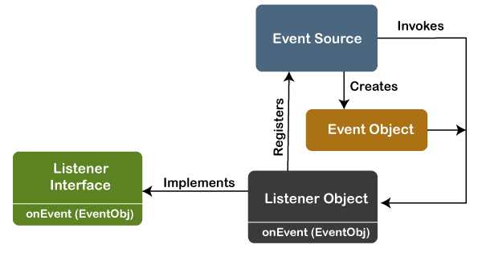
Delegation Event model
Source: Events are generated from the source. There are various sources like buttons, checkboxes, list, menu-item, choice, scrollbar, text components, windows, etc., to generate events.
Listeners: Listeners are used for handling the events generated from the source. Each of these listeners represents interfaces that are responsible for handling events.
Notes:
Duplicate this slide as necessary if there is more than one issue.
This and related slides can be moved to the appendix or hidden if necessary.

Slide 15
Steps to perform Event handling
Step 1: Create a new class which extends Applet class and implements appropriate Listener Interface.
Step 2: To perform Event Handling, we need to register the source with the listener.
Syntax: addTypeListener()
Example 1: For KeyEvent we use addKeyListener() to register.
Step 3: Finally implement abstract method of Listener Interface which contains the logic of event handling
Example 1: For KeyListener
                keyTyped()
                keyPressed()
                keyReleased()
Notes:
Duplicate this slide as necessary if there is more than one issue.
This and related slides can be moved to the appendix or hidden if necessary.

Slide 16
Event Classes in Java
Event Class | Listener Interface | Description
ActionEvent | ActionListener | When button click or selecting an item from the menu-item list.
ItemEvent | ItemListener | When an item was selected or not from list.
KeyEvent | KeyListener | When keypresses on the keyboard.
MouseEvent | MouseListener & MouseMotionListener | When the user interaction with the mouse (Pointing Device).
MouseWheelEvent | MouseWheelListener | When mouse wheel was rotated in a component.

Slide 17
Different interfaces consists of different methods
Listener Interface | Methods
ActionListener | actionPerformed()
ItemListener | itemStateChanged()
KeyListener | keyTyped() keyPressed() keyReleased()
MouseListener | mousePressed() mouseClicked() mouseEntered() mouseExited() mouseReleased()
MouseMotionListener | mouseMoved() mouseDragged()
MouseWheelListener | mouseWheelMoved()

Slide 18
Mouse Event Handling
import java.awt.*;
import java.applet.Applet;
import java.awt.event.*;
public class StatusApplet2 extends Applet implements MouseListener {
public void init() {
addMouseListener(this); //Step 1
}
public void mouseClicked(MouseEvent e) {
showStatus("Mouse Clicked");
setBackground(Color.red);
repaint();
}

Slide 19
public void mousePressed(MouseEvent e) {
showStatus("Mouse Pressed");
setBackground(Color.green);
}
public void mouseReleased(MouseEvent e) {
showStatus("Mouse Released");
setBackground(Color.blue);
}
public void mouseEntered(MouseEvent e) {
showStatus("Mouse black");
setBackground(Color.black);
}
public void mouseExited(MouseEvent e) {
showStatus("Mouse Exited");
setBackground(Color.yellow);
} }

Slide 20
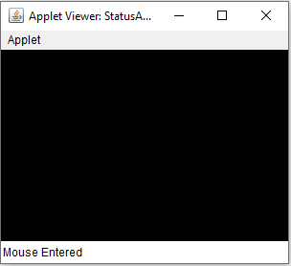
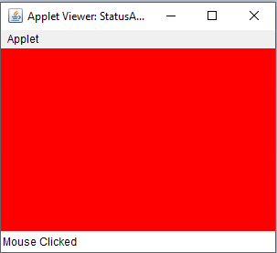
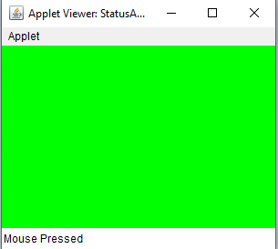
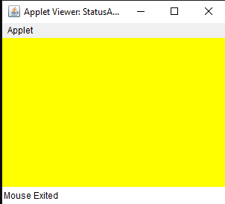

Slide 21
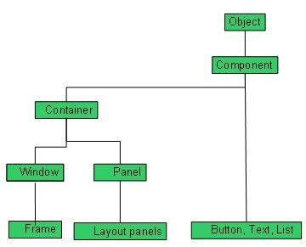
What is AWT?
AWT stands for Abstract Window Toolkit. It is an initial toolkit library provided by Java to create a Graphical User Interface.

Slide 22
Sr. No. | Control & Description
1 | Label A Label object is a component for placing text in a container.
2 | Button This class creates a labeled button.
3 | Check Box A check box is a graphical component that can be in either an on (true) or off (false) state.
4 | Check Box Group The CheckboxGroup class is used to group the set of checkbox.
5 | List The List component presents the user with a scrolling list of text items.
6 | Text Field A TextField object is a text component that allows for the editing of a single line of text.
7 | Text Area A TextArea object is a text component that allows for the editing of a multiple lines of text.
8 | Choice A Choice control is used to show pop up menu of choices. Selected choice is shown on the top of the menu.

Slide 23
Creating Controls in Java AWT Applet
To create controls (Button, Label, TextField, etc.) in an Applet, the steps are:
Import awt and applet packages
Extend the Applet class
Create controls inside init()
Add controls using add()

Slide 24
Label and TextField
import java.applet.Applet;
import java.awt.*;
public class ControlsApplet extends Applet {
Label lbl;
TextField tf;
public void init() {
lbl = new Label("Enter Name:");
tf = new TextField(20);
add(lbl);
add(tf);
}
}

Slide 25
Checkbox cb;
CheckboxGroup cg;
Checkbox male, female;
Button btn;
public void init() {
cb = new Checkbox("I Agree");
cg = new CheckboxGroup();
male = new Checkbox("Male", cg, true);
female = new Checkbox("Female", cg, false);
add(cb);
add(male);
add(female);
btn = new Button("Submit");
add(btn);
}

Slide 26
import java.applet.Applet;
import java.awt.*;
public class AllControlsApplet extends Applet {
public void init() {
add(new Label("Name:"));
add(new TextField(20));
add(new Button("Submit"));
add(new Button("Clear"));
add(new Checkbox("I Agree"));
CheckboxGroup cg = new CheckboxGroup();
add(new Checkbox("Male", cg, true));
add(new Checkbox("Female", cg, false));

Slide 27
Choice ch = new Choice();
ch.add("Java");
ch.add("Python");
ch.add("C++");
add(ch);
List lst = new List(4, true);
lst.add("Red");
lst.add("Blue");
lst.add("Green");
lst.add("Black");
add(lst);
add(new TextArea(5, 20));
} }

Slide 28
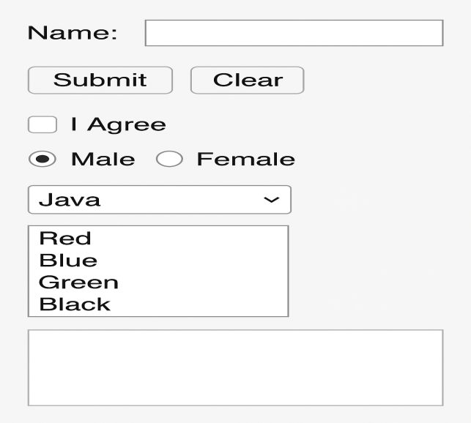

Slide 29
Introduction to Java Swing
Swing is a Java Foundation Classes [JFC] library and an extension of the Abstract Window Toolkit [AWT]. .
Java Swing offers much-improved functionality over AWT, new components, expanded components features, and excellent event handling with drag-and-drop support.
Swing is a Set of API (API- Set of Classes and Interfaces) which Provided to Design Graphical User Interfaces
Swing is an Extension library to the AWT which Includes New and improved Components that have been enhancing the looks and Functionality of GUIs’
Notes:
Duplicate this slide as necessary if there is more than one issue.
This and related slides can be moved to the appendix or hidden if necessary.

Slide 30
Difference between Java Swing and Java AWT
Java AWT | Java Swing
Java AWT is an API to develop GUI applications in Java. | Swing is a part of Java Foundation Classes and is used to create various applications.
Components of AWT are heavy weighted. | The components of Java Swing are lightweight.
Components are platform dependent. | Components are platform independent.
Execution Time is more than Swing. | Execution Time is less than AWT.
AWT components require java.awt package. | Swing components requires javax.swing package.
Notes:
Duplicate this slide as necessary if there is more than one issue.
This and related slides can be moved to the appendix or hidden if necessary.

